Slide 2
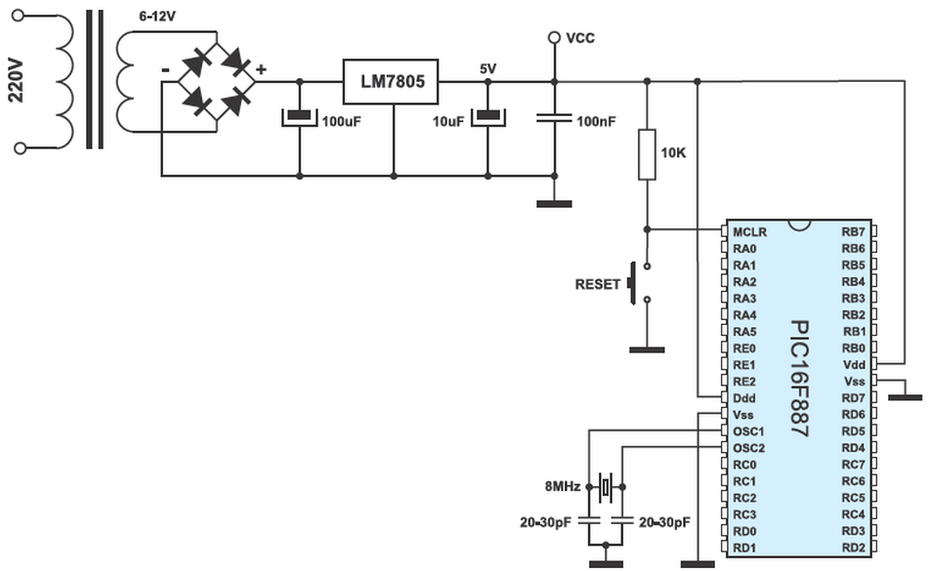
BASIC CONNECTING

Slide 3
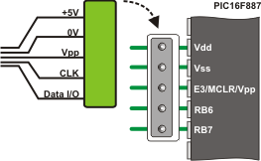
PINS FOR PROGRAMMING

Slide 4
INPUT/OUTPUT PORTS
Every port has its corresponding TRIS register: TRISA, TRISB, TRISC etc. which determines the performance of port bits, but not their contents.
By clearing any bit of the TRIS register (bit=0), the corresponding port pin is configured as an output. Similarly, by setting any bit of the TRIS register (bit=1), the corresponding port pin is configured as an input.
This rule is easy to remember 0 = Output, 1 = Input.

Slide 5
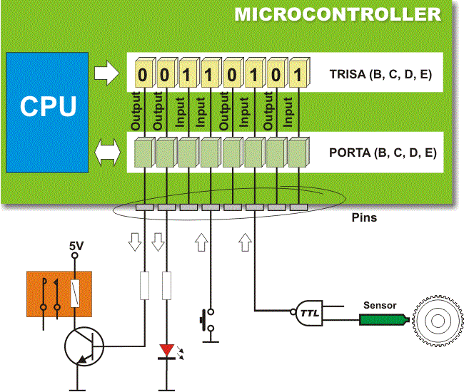
INPUT/OUTPUT PORTS

Slide 6
PORT B PULL-UP
All the port B pins have built in pull-up resistors, which make them ideal for connection to push buttons (keyboard), switches and optocouplers.
In order to connect these resistors to the microcontroller ports, the appropriate bit of the WPUB register should be set

Slide 7
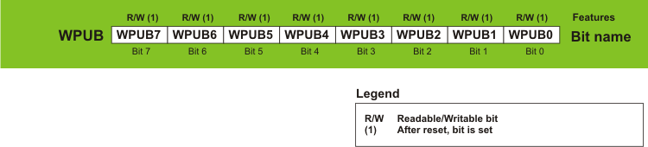
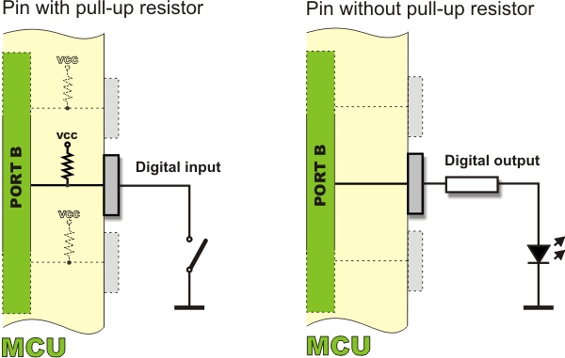
PORT B PULL-UP

Slide 8
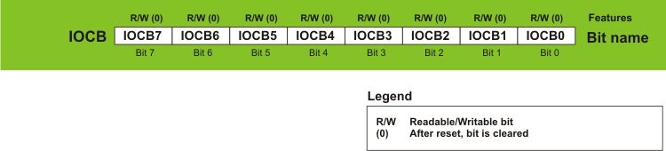
INTERRUPT PORT B
If enabled, each port B bit configured as an input may cause an interrupt by changing its logic state.
In order to enable pins to cause an interrupt, the appropriate bit of the IOCB register should be set.

Slide 9
MAIN I/O COMMANDS
output_low(pin)
this command will set the pin to 0
Ex: output_low(pin_d0);
this command sets the pin D0 to 0
output_high(pin)
this command will set the pin to 1
Ex: output_high(pin_d0);
this command sets the pin D0 to 1

Slide 10
MAIN I/O COMMANDS
output_bit(pin, value)
this command will set the pin to 0 or 1 base on value
Ex: output_bit(pin_d0, 1) ;
this command sets the pin D0 to 1

Slide 11
MAIN I/O COMMANDS
input(pin)
read the value of pin
ex :
int1 x;
x=input(pin_d0);
read the value of pin D0 and save in x

Slide 12
MAIN I/O COMMANDS
output_X(value)
for PORT X (A-E) outputs “value” to the entire port
ex :
output_d(0x0f) ;
4 lower bits of portd are set to 1 and 4 higher bit ofs portd are set to 0

Slide 13
MAIN I/O COMMANDS
input_X()
read the value of PORT X (A-E)
ex :
usigned int8 temp;
temp = input_d() ;
read the value of portd and save in temp

Slide 14
MAIN I/O COMMANDS
port_b_pullups(value)
allows the use of pullup resistors on individual pins of port B
Ex:
port_b_pullups(0x80);
Enable pullup resistor for pin b7 others are disable

Slide 15
MAIN I/O COMMANDS
set_tris_X(value)
set the data direction. Bit 1 indicates input, bit 0 indicates output .
Ex:
set_tris_d(0x01);
Pin d0 is input others are output

Slide 16

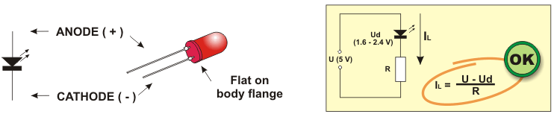
LED DIODES
Ex: control 8 leds connected with portd on – off.

Slide 17
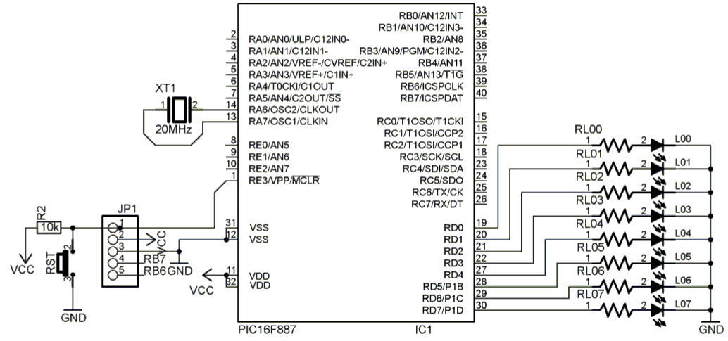
SCHEMATIC

Slide 18
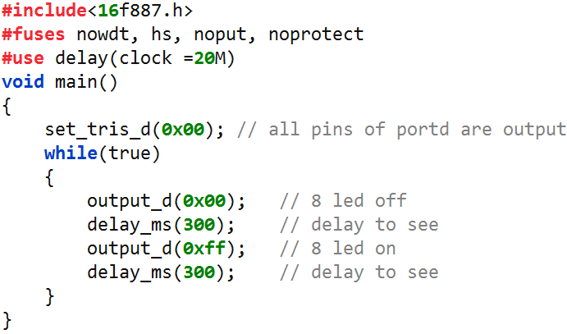
CODE

Slide 19
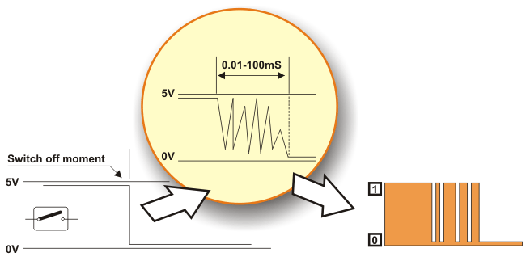
BUTTON
Push-buttons are probably the simplest devices providing the simplest way of detecting the appearance of a voltage on a microcontroller input pin. Nevertheless, it is not as simple as it seems... The reason for it is a contact bounce.

Slide 20
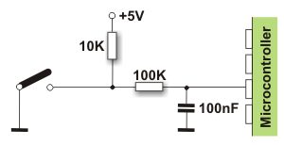
BUTTON
This problem may be easily solved by connecting a simple RC circuit to suppress quick voltage changes.

Slide 21
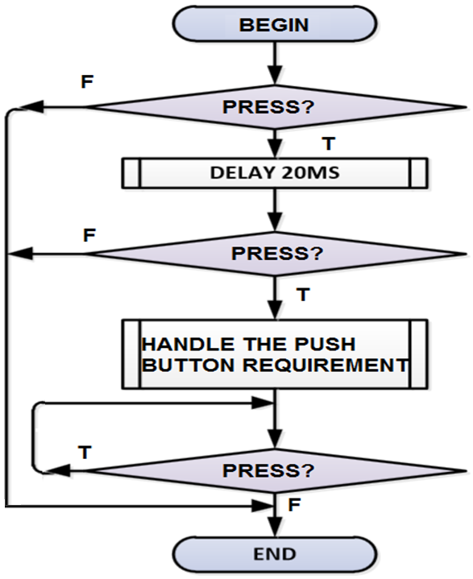
BUTTON
This problem also can be easily solved by the software

Slide 22
BUTTON
Ex: Control 8 leds connected with portd on/off by on/off button connected with pin E0. If the current status of leds are on when pushing the button leds will be off and if leds are off when pushing leds will be on.

Slide 23
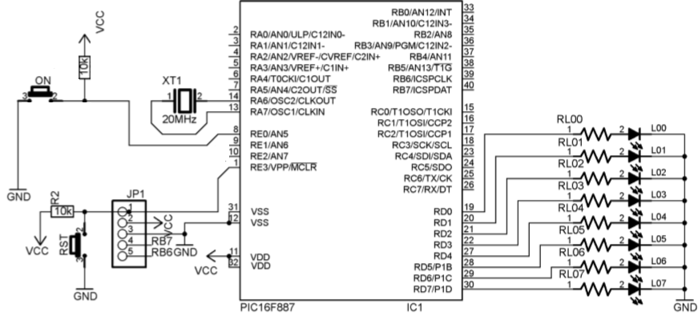
SCHEMATIC

Slide 24
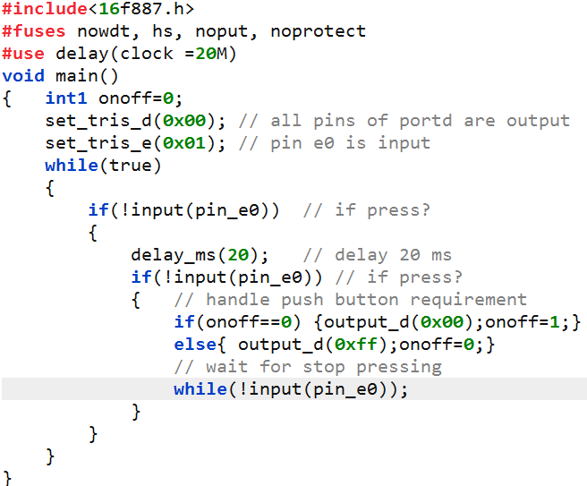
CODE

Slide 25
Test the theory by simulink

Slide 26
Thank You !

